Slide 1
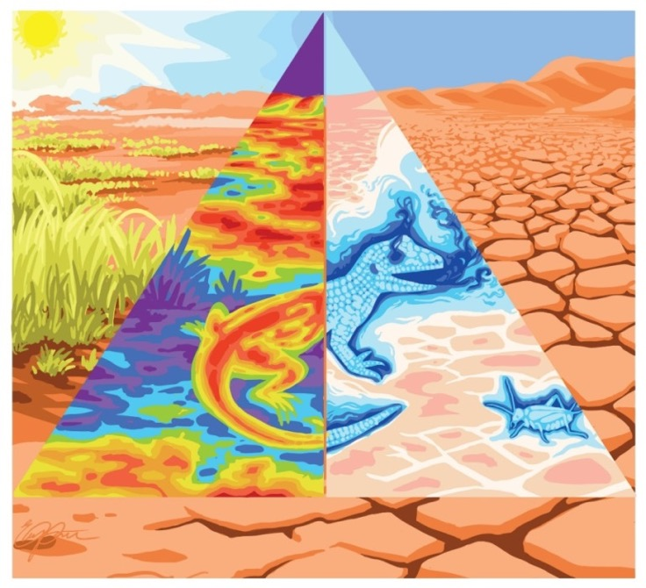

Mechanistic Niche Modelling
Michael Kearney¹ & Lauren Buckley²
Credit: Elia Pirtle
School of BioSciences, The University of Melbourne
Department of Biology, The University of Washington
Notes:
Let the concept of trait be theoretical. My coauthors are Melodie McGeoch who is a community ecologist and is here at this meeting, and Steven Chown who is a physiological ecologist, and the three of us use functional traits routinely in our work but in slightly different ways. We certainly don’t feel that we’ve fully resolved these ideas and we’re very keen to get your opinions and advice on the contents of this talk

Slide 2
Program
Time | Topic
9:00 -9:15 | Introductions
9:15-9:45 | What are mechanistic niche models and why do we need them? (MK & LB)
9:45-10:15 | Calculating body temperature with TrenchR (LB)
10:15-10:30 | Break
10:30-11:15 | Intro to microclimate modelling with NicheMapR (MK)
11:15-12:00 | Selecting microclimate data (LB & MK)
12:00-13:00 | Lunch Break
13:00-13:45 | Calculating body/leaf temperature with NicheMapR (MK)
13:45-14:45 | Mass budgets with NicheMapR: Dynamic energy budgets (DEB) and water balance (MK)
14:45-15:00 | Break
15:00-16:00 | Q&A on mechanistic niche modelling (LB & MK)

Slide 3
Program
Time | Topic
9:00 -9:15 | Introductions
9:15-9:45 | What are mechanistic niche models and why do we need them? (MK & LB)
9:45-10:15 | Calculating body temperature with TrenchR (LB)
10:15-10:30 | Break
10:30-11:15 | Intro to microclimate modelling with NicheMapR (MK)
11:15-12:00 | Selecting microclimate data (LB & MK)
12:00-13:00 | Lunch Break
13:00-13:45 | Calculating body/leaf temperature with NicheMapR (MK)
13:45-14:45 | Mass budgets with NicheMapR: Dynamic energy budgets (DEB) and water balance (MK)
14:45-15:00 | Break
15:00-16:00 | Q&A on mechanistic niche modelling (LB & MK)

Slide 4
What are Mechanistic Niche Models?
Credit: Elia Pirtle
Notes:
Let the concept of trait be theoretical. My coauthors are Melodie McGeoch who is a community ecologist and is here at this meeting, and Steven Chown who is a physiological ecologist, and the three of us use functional traits routinely in our work but in slightly different ways. We certainly don’t feel that we’ve fully resolved these ideas and we’re very keen to get your opinions and advice on the contents of this talk

Slide 5
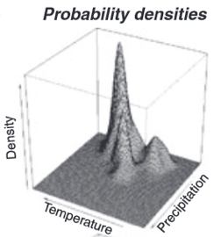
Ecological Niche Modelling
Correlative Model (process implicit)
Maxent model
probability of occurrence
Environmental Layers
Notes:
My area of research involves what is often called niche modelling – this generally involves characterising the suitable environments for a given species, e.g. this stumpy tailed lizard from Australia, and mapping them through space and time using the increasingly rich environmental data we have at our disposal. The most common approach is what is often called correlative niche modelling, where the starting point is occurrence records – one of the most common types of biodiversity data. I’m focussed here on a mechanistic approach to the problem where you start instead with the functional traits of the organism and try to explicitly link them to environmental variables to infer where organisms can and cannot exist. The way this is done is using the principles of thermodynamics

Slide 6
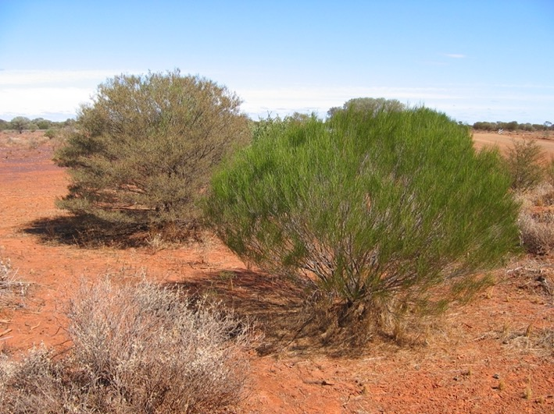


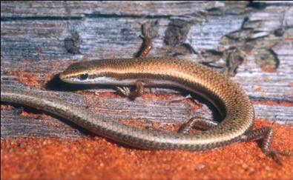
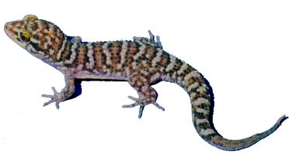
Habitat vs. environment vs. niche
Habitat: a description of a physical place, at a particular
scale of space and time, where an organism either actually
or potentially lives.
Environment: the biotic and abiotic phenomena surrounding and potentially interacting with an organism.
Niche: a subset of those environmental conditions which
affect a particular organism, where the average absolute
fitness of individuals in a population is greater than or
equal to one.
Bynoe’s gecko
Grey’s skink
Kearney, M. 2006. Habitat, environment and niche: what are we modelling? — Oikos 115: 186-191.

Slide 7
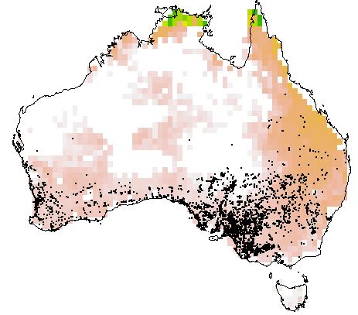
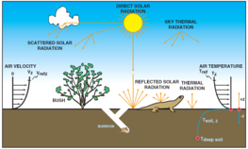
Ecological Niche Modelling
Correlative Model (process implicit)
Maxent model
probability of occurrence
Environmental Layers
Mechanistic Model (process explicit)
potential reproduction
Thermodynamic Model
Notes:
My area of research involves what is often called niche modelling – this generally involves characterising the suitable environments for a given species, e.g. this stumpy tailed lizard from Australia, and mapping them through space and time using the increasingly rich environmental data we have at our disposal. The most common approach is what is often called correlative niche modelling, where the starting point is occurrence records – one of the most common types of biodiversity data. I’m focussed here on a mechanistic approach to the problem where you start instead with the functional traits of the organism and try to explicitly link them to environmental variables to infer where organisms can and cannot exist. The way this is done is using the principles of thermodynamics

Slide 8
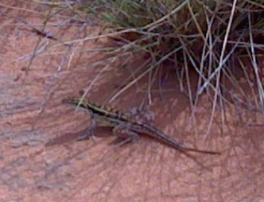
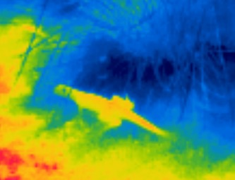
The organism as a thermodynamic system
energy in =
energy out + energy stored
SURROUNDINGS
in
in
SYSTEM
out
mass in =
mass out + mass stored
out
BOUNDARY
Notes:
All organisms are in a state of constant exchange of energy and materials with their environments – take this lizard, for example, which, when you see it infrared, is clearly not at thermal equilibrium with its environment and is undergoing a process of heat energy exchange – in a thermodynamic analysis you draw a boundary around the organism defining it as a system, and you can write out the terms that describe the flux of energy and of mass between it and its environment

Slide 9
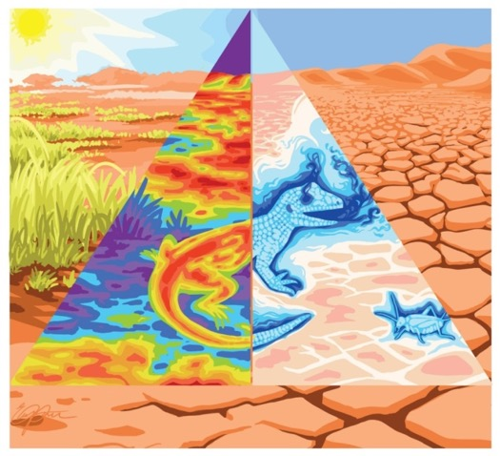
The organism as a thermodynamic system
energy in =
energy out + energy stored
SURROUNDINGS
in
in
SYSTEM
out
mass in =
mass out + mass stored
out
BOUNDARY
temperature
fe ding
breathing
br athing
temperature
water
wa er
feeding
Credit: Elia Pirtle
Notes:
In this way we can capture the fundamental conditions of survival – how hot the animal is, how takes up food and uses it for growth and reproduction, how it respires and its water balance. These processes are tightly and formally connected in a thermodynamic sense in the way these words are arranged

Slide 10
The organism as a thermodynamic system
energy in =
energy out + energy stored
SURROUNDINGS
in
in
SYSTEM
out
mass in =
mass out + mass stored
out
BOUNDARY
Credit: Elia Pirtle
Notes:
The underlying equations involve terms that have parameters relating to the organism’s properties or traits, and variables relating to the environment, and they predict the organism’s ‘state’ e.g. its energy balance, its heat balance or its water balance. For example, the solar radiation term involves parameters relating to surface area and solar absorptivity, and variables relating to the solar radiation field. In this short talk I can’t elaborate on all these terms but what I want to emphasise is the connection between theory, these kinds of equations and traits

Slide 11

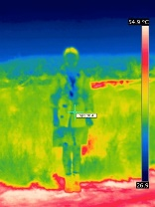
The Thermodynamic Niche
Heat pathways
Mass pathways
SOLAR = solar radiation
IR = infrared radiation
MET = metabolism
CONV = convection
EVAP = evaporation
COND = conduction
X = food
O2 = oxygen
CO2 = carbon dioxide
N = nitrogenous waste
H = water
Q = heat flux J/s
J = mass flux kg/s
fe ding
Q_{SOLAR}
J_{O2,MET}
+
+
Q_{IR,in}
br athnig
+
temperature
Allocation
Q
S = stored
I = ingested
G = growth
R = reproduction
P = product (faeces)
U = urinated
J_{X,I}
=
J
+
J_{X,G}
+
J_{X,R}
+
J_{X,S}
+
J_{X,P}
wa er
=
MET
=
J_{CO2,MET}
Q_{IR,out}
+
+
Q_{CONV}
J_{N,MET}
+
+
Q
J_{H,I}
+
=
J_{H,U}
J_{H,P}
J_{H,S}
J_{H,MET}
+
+
+
J
EVAP
+
heat
Q_{COND}
C₆H₁₂O₆ + 6 O₂ → 6 CO₂ + 6 H₂O
+
Q_{S}
Kearney et al. Functional Ecology (2013) after Porter and Tracy (1983)

Slide 12
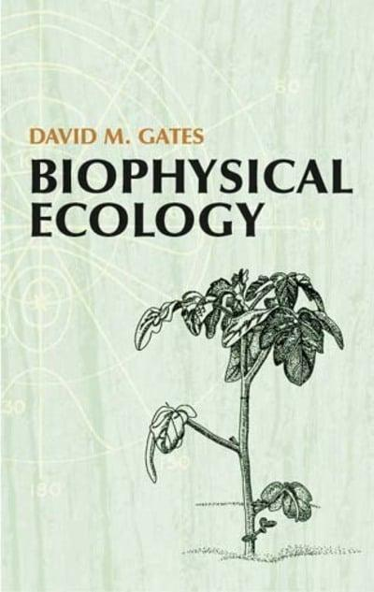
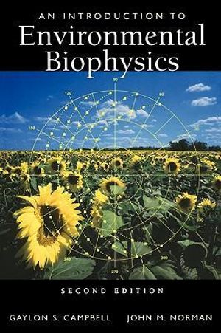
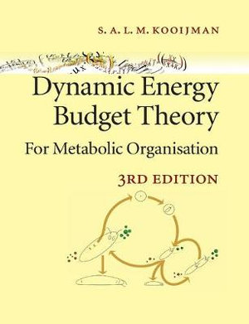
Theory for Mechanistic Niche Modelling
heat and water
exchange
microclimate
metabolism
Notes:
The relevant theories from which these equations are derived are in the branches of ‘biophysical ecology’ and ‘metabolic theory’, biophys being focused on the impact of the external physical environment on the organism in terms of its heat budget and water budget. Metabolic theory is concerned with thermodynamic constraints on the internal processes by which the organism transforms food and other nutrients into growth, development and reproduction, and one of the most useful and general metabolic theories is Dynamic Energy Budget theory, which was developed here in the Netherlands by Bas Kooijman and colleagues.

Slide 13
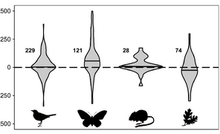
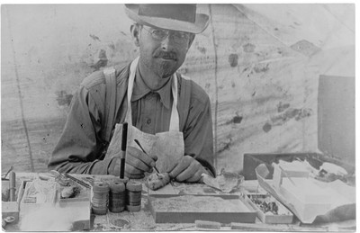
How can we solve the problem of unpredictability in climate change biology?
Heterogenous elevation shifts over 20th century in CA
Relative elevational shift (m/30yrs)
MVZ Grinnell Resurvey
(Rapacciuolo et al. 2014)

Slide 14
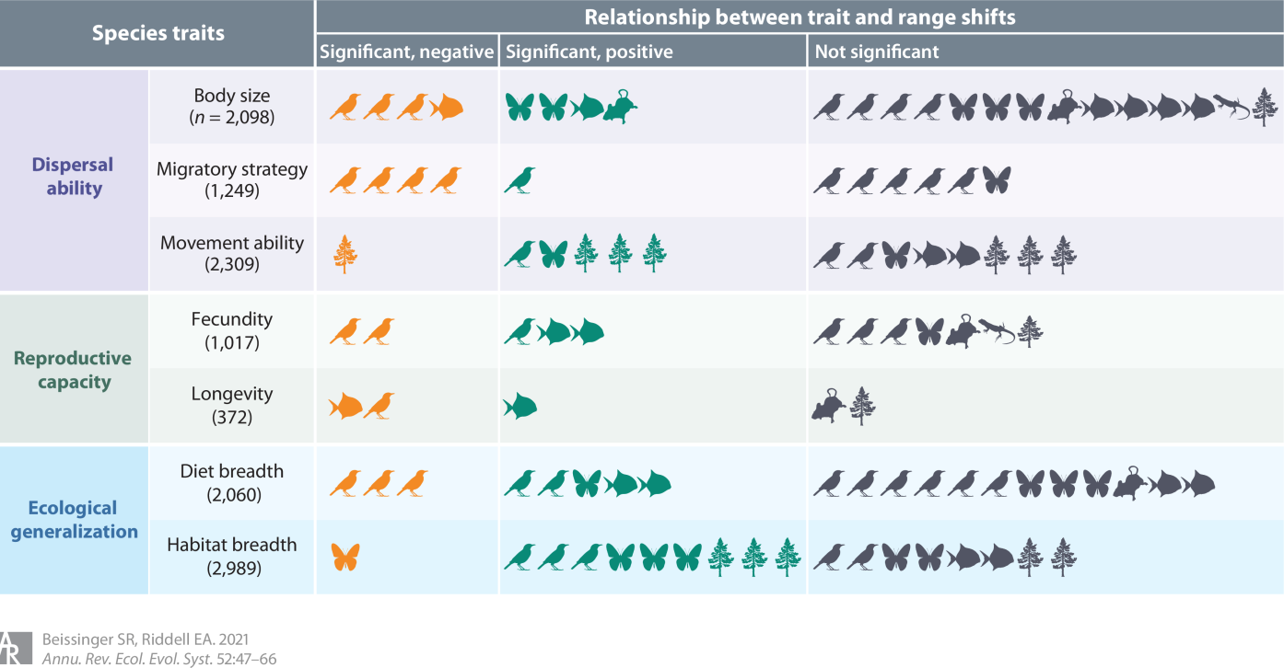
Traits poor predictors of range shifts
-
+
o
(Beissinger and Riddell 2021 AREE)

Slide 15
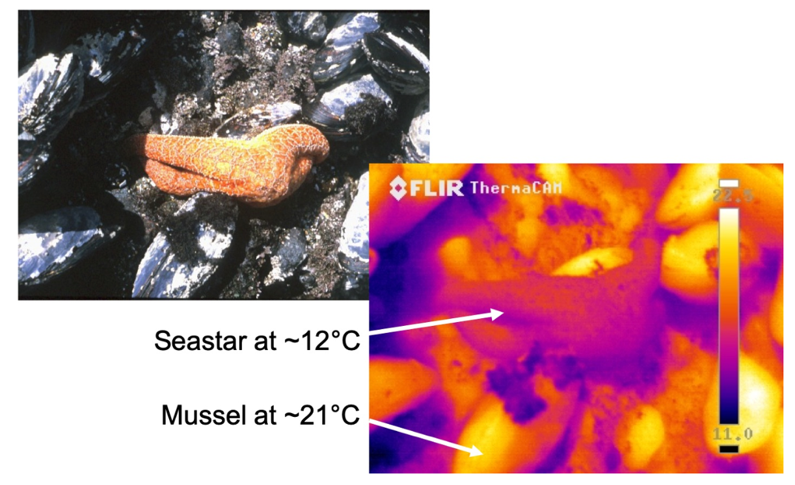
Thinking beyond air temperature to understand how organisms experience climate change
Brian Helmuth

Slide 16
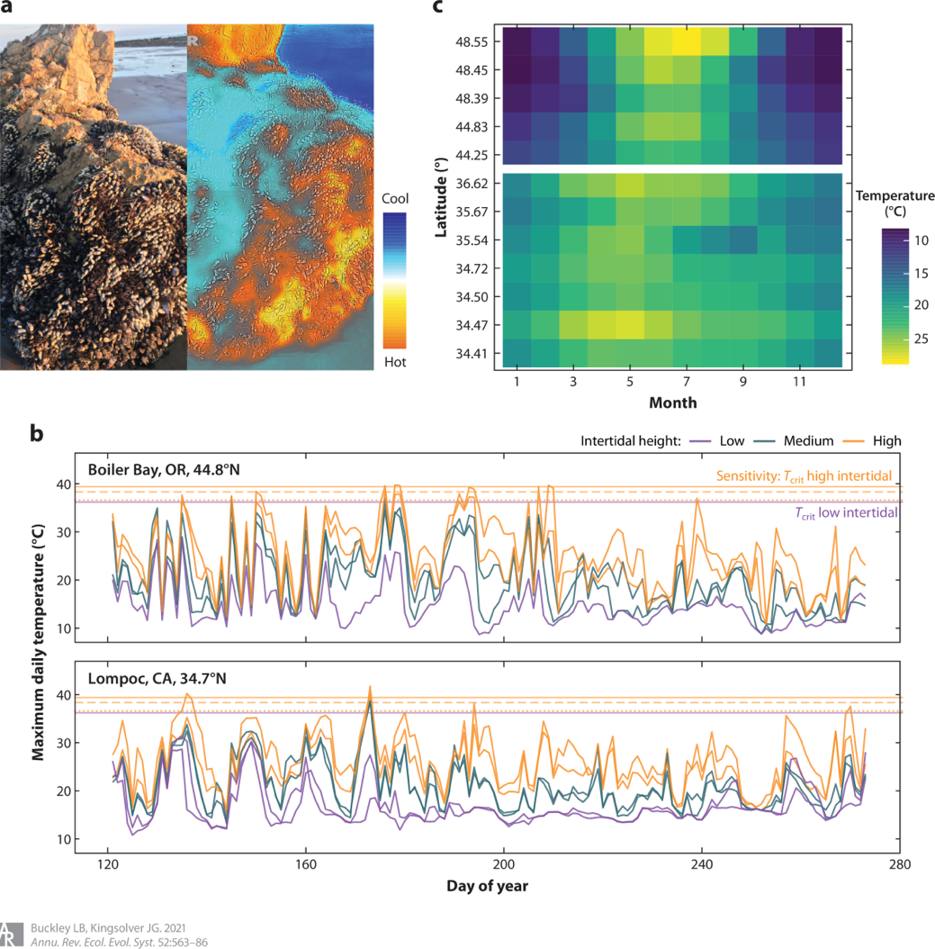
Need to consider both environmental exposure and organismal sensitivity to climate change and variability
(Buckley and Kingsolver 2021 AREE)

Slide 17
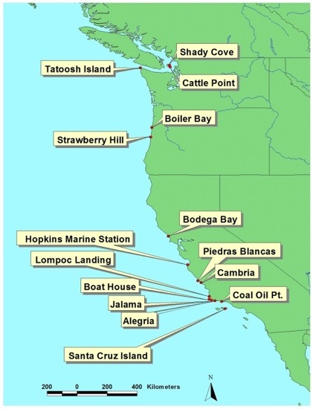
Thermal stress deviates from expected latitudinal gradient
Maximum Daily Temp (°C)
(Helmuth et al. 2002 Science)
Notes:
17

Slide 18
(Buckley et al. 2023 PLoS Climate)

Slide 19
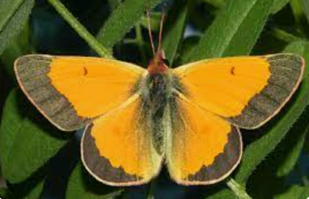
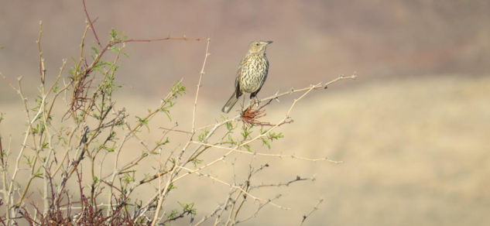
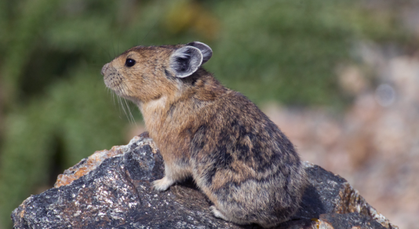
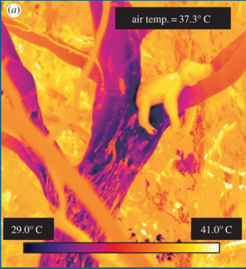
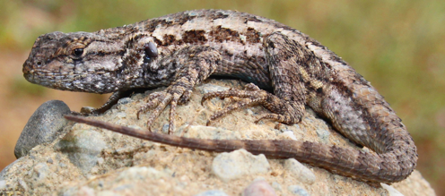
Mechanisms driving climate change responses
Increased butterfly thermal opportunity offsets survival impacts of thermal extremes
(Buckley and Kingsolver 2019)
Desert mammals fare better than birds due to capacity to buffer thermal extremes
(Riddell et al. 2021)
Pika behavioral buffering of extremes reduces habitat loss
(Mathewson et al. 2017)
Longer lizard reproductive season offsets early life stage survival impacts of thermal extremes
(Levy et al. 2016)
Koala distributions limited by water stress associated with heatwaves and rainfall timing
(Briscoe et al. 2016)
(Buckley et al. 2023 PLoS Climate)

Slide 20
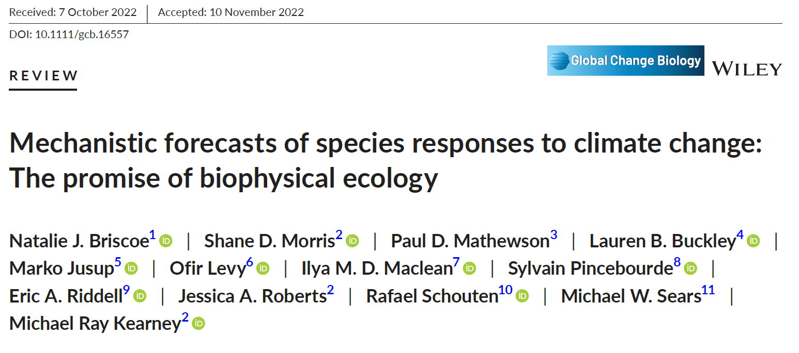

Slide 21
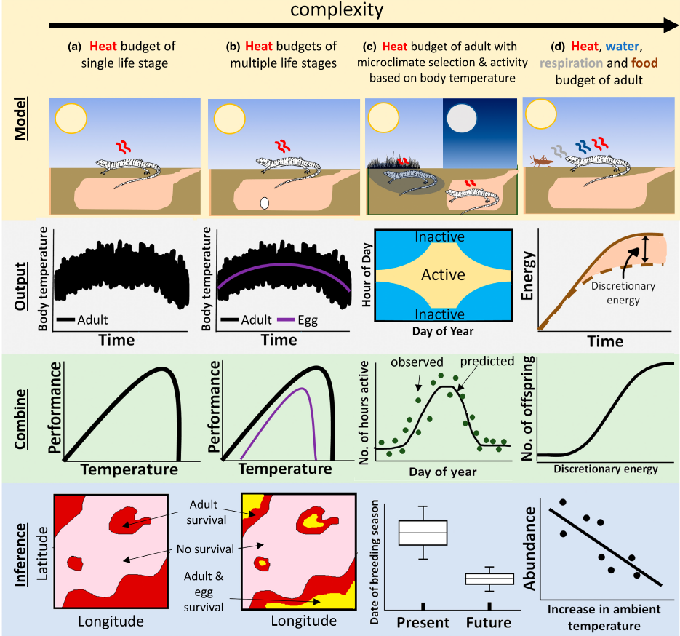

Slide 22
Program
Time | Topic
9:00 -9:15 | Introductions
9:15-9:45 | What are mechanistic niche models and why do we need them? (MK & LB)
9:45-10:15 | Calculating body temperature with TrenchR (LB)
10:15-10:30 | Break
10:30-11:15 | Intro to microclimate modelling with NicheMapR (MK)
11:15-12:00 | Selecting microclimate data (LB & MK)
12:00-13:00 | Lunch Break
13:00-13:45 | Calculating body/leaf temperature with NicheMapR (MK)
13:45-14:45 | Mass budgets with NicheMapR: Dynamic energy budgets (DEB) and water balance (MK)
14:45-15:00 | Break
15:00-16:00 | Q&A on mechanistic niche modelling (LB & MK)

Slide 23

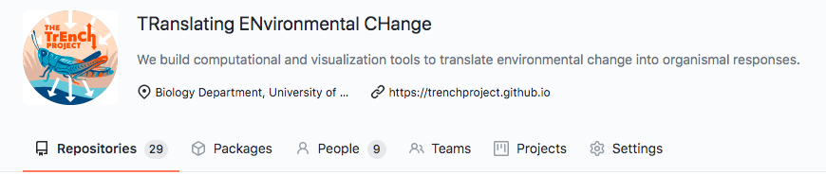
Tools for Translating Environmental Change into organismal responses
trenchproject.com

Slide 24
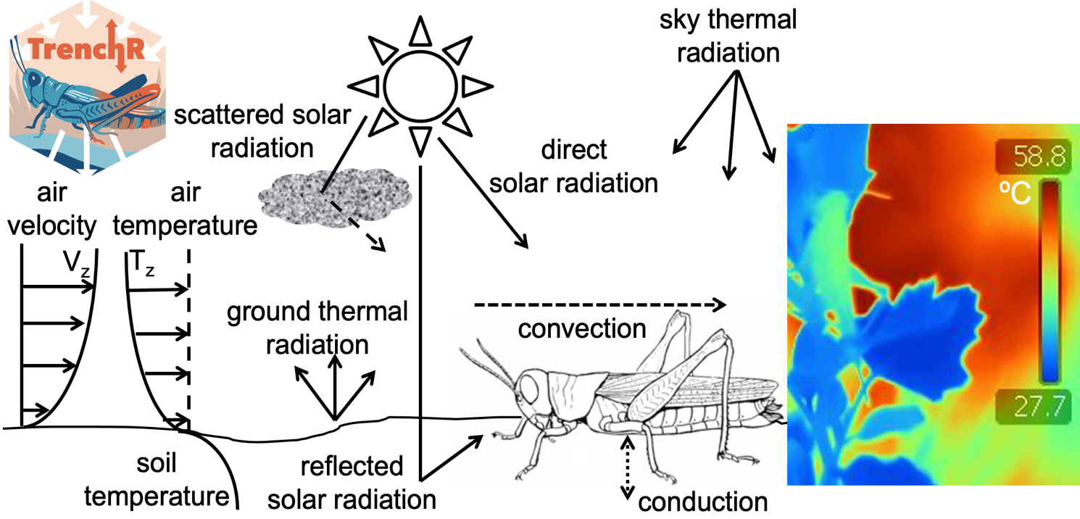
TrenchR
R package for modular and accessible
microclimate and biophysical modelling

Slide 25
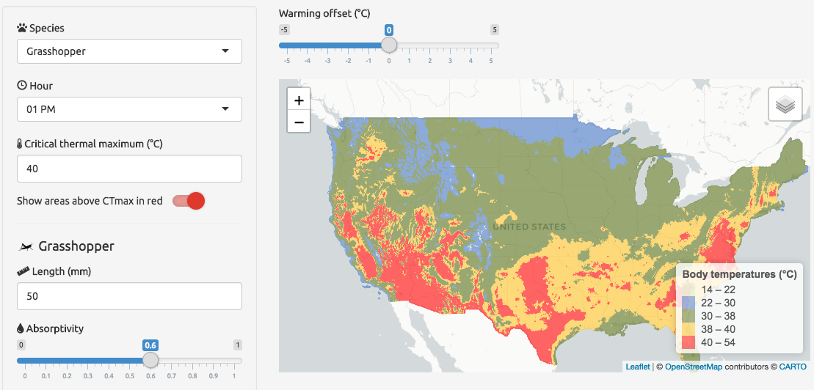

TrEnCh Map:
interfaces for examining thermal stress

Slide 26
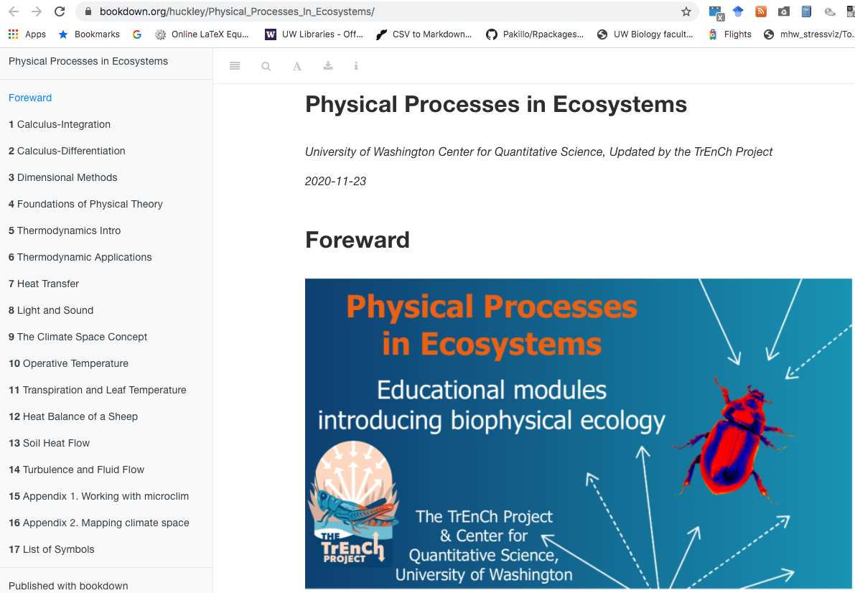
Education modules for researchers

Slide 27

Notes:
https://docs.google.com/document/d/1086BgAkPZkC0bXRR7PVYdudy5q_RpoEk8BTz2WFS3eM/edit

Slide 28
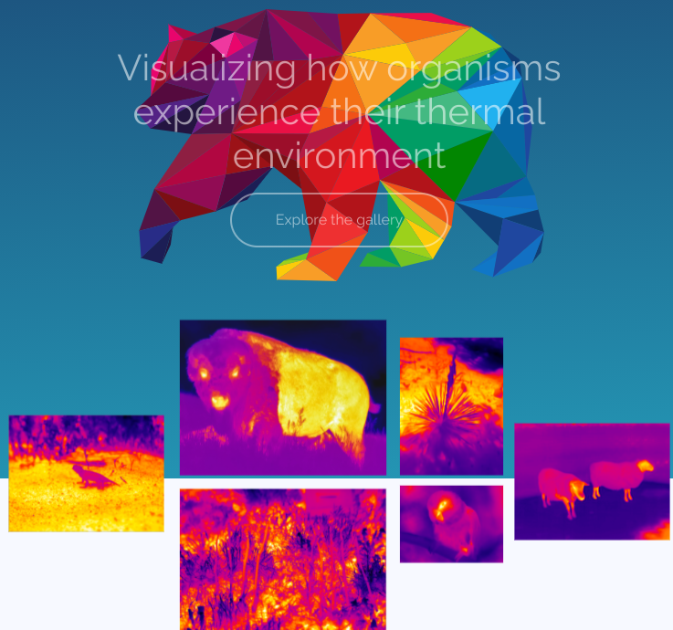


TrEnCh-IR thermal image repository
Notes:
IR images exploring thermal complexity of life

Slide 29
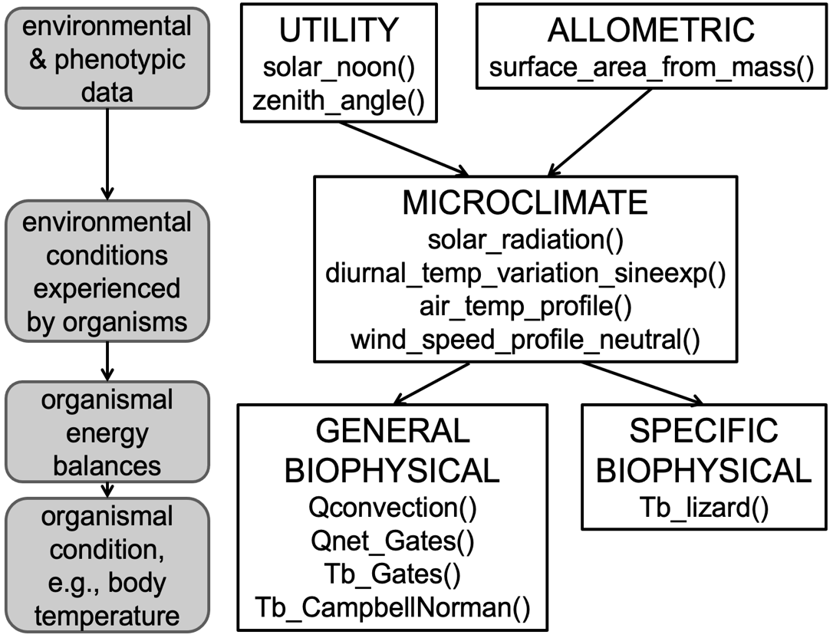


Slide 30
Theory for Mechanistic Niche Modelling
heat and water
exchange
Notes:
The relevant theories from which these equations are derived are in the branches of ‘biophysical ecology’ and ‘metabolic theory’, biophys being focused on the impact of the external physical environment on the organism in terms of its heat budget and water budget. Metabolic theory is concerned with thermodynamic constraints on the internal processes by which the organism transforms food and other nutrients into growth, development and reproduction, and one of the most useful and general metabolic theories is Dynamic Energy Budget theory, which was developed here in the Netherlands by Bas Kooijman and colleagues.

Slide 31
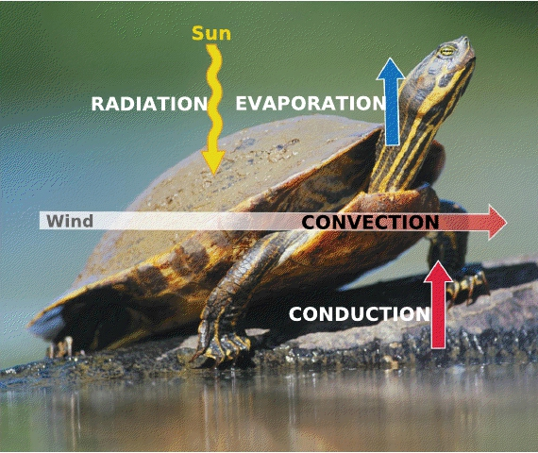
Net heat exchange with environment
Q_{net}= + Q_{rad} + Q_{met} + Q_{cond}+ Q_{conv}- Q_{evap}

Slide 32
Net heat exchange with environment
Q_{net}= + Q_{rad} + Q_{met} + Q_{cond}+ Q_{conv}- Q_{evap}
(+Q_{stor}+Q_{work})
If not steady state:
Δheat
Work against environmental gradient
Organism core vs surface temperature
T_{b}- T_{a}=(T_{b}-T_{s}) + (T_{s}-T_{a})
T_{s}: T organism surface; T_{b}: T body

Slide 33
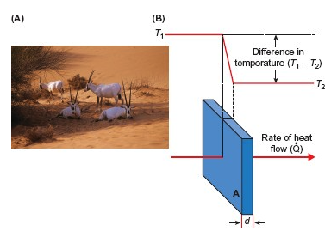
Diffusion
Movement from high to low concentration.
Plus diffusion coefficient
(Butler et al. Animal Physiology)
Notes:
Fourier’s law of heat conduction applies broadly

Slide 34
Radiation
A heat transfer between two substances that are not in contact.
Q_{rad}= εσAT⁴
Thermal radiation
from (body) surface
Thermal radiation
between organism and enclosed environment
Q_{rad}= εσA(T_{s}⁴-T⁴)
A: Surface area
T: Temperature, s= surface
ε: Emissivity (proportion radiated)
σ: Stefan-Boltzmann constant
Notes:
Can gain heat via radiation if sit in sun, or lose if sit in a room next to a cold window.

Slide 35
Conduction
A heat transfer involving two objects in physical contact with each other.
Temperature
gradient
Q_{cond}= -kA(T₂-T₁)
(X₂-X₁)
Separation,
e.g., thickness of animal skin
A: Surface area
T: Temperature
k: thermal conductivity
X: position
Notes:
Example of importance of k.
Go to sauna, sit on wood or sit on metal
Can gain or lose heat by conduction (sit on hot rock, sit on cold ice)

Slide 36
Convection
A heat transfer between a solid and a liquid or a gas.
Q_{conv}= h_{c}A(T_{s}⁻T_{a})
A: Surface area
h_{c}: convective coefficient
T_{s}: organism surface temperature
T_{a}: ambient temperature
Notes:
Can gain or lose heat by convection

Slide 37
Convection
A heat transfer between a solid and a liquid or a gas.
Q_{conv}= h_{c}A(T_{s}⁻T_{a})
h_{c} depends on type of convection:
within boundary layer (stagnant air)
free convection driven by density differential
forced by wind or current
Important factors:
fluid velocity, viscosity, density
organism dimensions
Notes:
Mention that the boundary layer increases with size – this will be important later in explaining why Te increases with size, all else equal

Slide 38
Evaporation
A loss of heat due to liquid water phase changing into gaseous water.
Q_{evap}= h_{d}A(ρ_{o}- ρ_{a})
A: Surface area
h_{d}: mass transfer coefficient
ρ_{o} : Saturated water vapor density
ρ_{a} : water vapor density of airmass
Notes:
Works only if pa is low. In WW II, recruits in basic training in the south suffered high mortality on days when the humidity was high. overheating

Slide 39
Rmd example
https://github.com/trenchproject/ESA_MechModelWorkshop/
TrenchR_TeExample.Rmd

Slide 40
Program
Time | Topic
9:00 -9:15 | Introductions
9:15-9:45 | What are mechanistic niche models and why do we need them? (MK & LB)
9:45-10:15 | Calculating body temperature with TrenchR (LB)
10:15-10:30 | Break
10:30-11:15 | Intro to microclimate modelling with NicheMapR (MK)
11:15-12:00 | Selecting microclimate data (LB & MK)
12:00-13:00 | Lunch Break
13:00-13:45 | Calculating body/leaf temperature with NicheMapR (MK)
13:45-14:45 | Mass budgets with NicheMapR: Dynamic energy budgets (DEB) and water balance (MK)
14:45-15:00 | Break
15:00-16:00 | Q&A on mechanistic niche modelling (LB & MK)

Slide 41
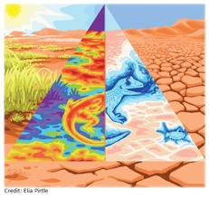

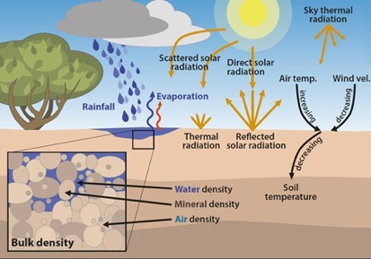
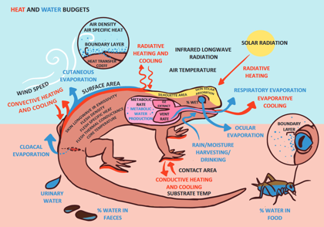
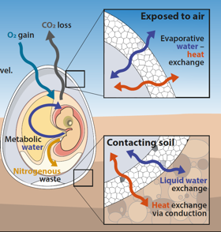
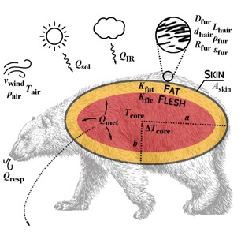
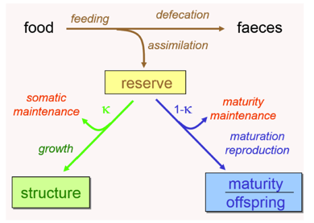
NicheMapR
microclimate model
ectotherm model
egg model
endotherm model
dynamic energy budget model
microclimate
DRYAIR
WETAIR
ectotherm
get_p_wet
egg_water
ellipsoid
endoR
endoR_devel
DEB
DEB_const
DEB_var
DEB_euler
plantgro
leaf_temperature
micro_global
micro_terra
micro_ncep
micro_era5
micro_aust
micro_usa
micro_uk
micro_nz
onelump
onelump_var
twolump

Slide 42

https://mrke.github.io/

Slide 43
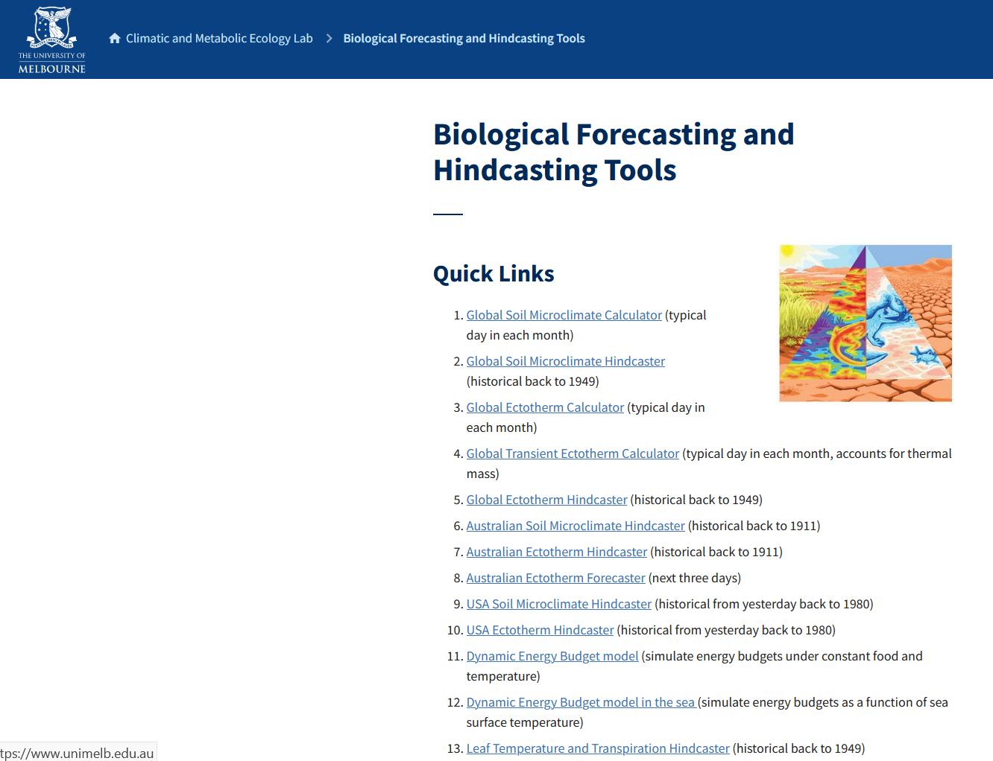
https://camel.science.unimelb.edu.au/biological-forecasting-and-hindcasting-tools/

Slide 44

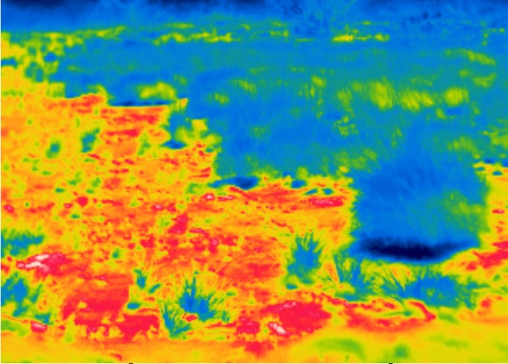
Microclimate
56
54
52
50
48
46
44
42
40
38
36
34
32
microclimate
Notes:
The relevant theories from which these equations are derived are in the branches of ‘biophysical ecology’ and ‘metabolic theory’, biophys being focused on the impact of the external physical environment on the organism in terms of its heat budget and water budget. Metabolic theory is concerned with thermodynamic constraints on the internal processes by which the organism transforms food and other nutrients into growth, development and reproduction, and one of the most useful and general metabolic theories is Dynamic Energy Budget theory, which was developed here in the Netherlands by Bas Kooijman and colleagues.

Slide 45
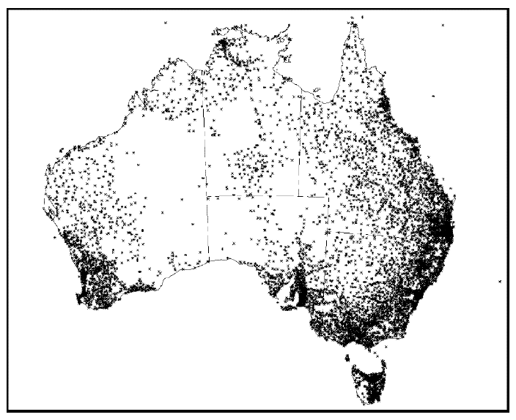
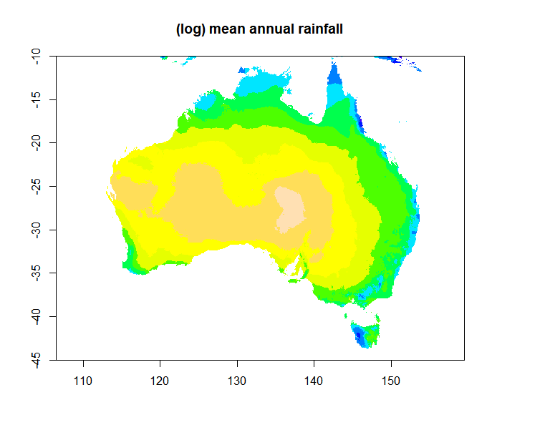
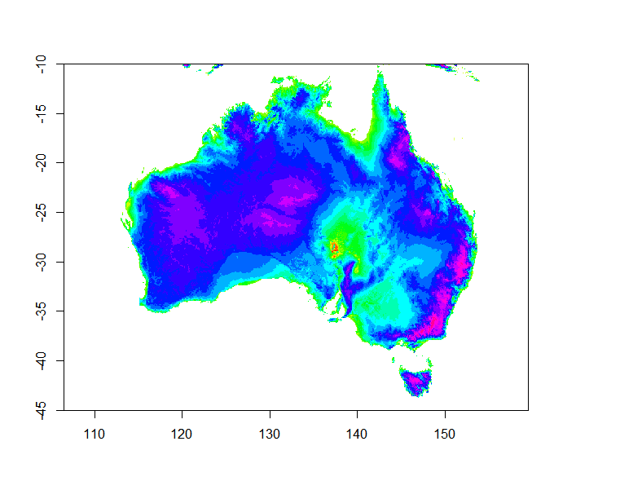
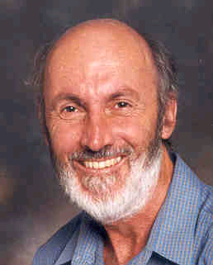
Microclimate
rainfall observations
mean annual rainfall
thin-plate
smoothing
splines
(Wabah and
Wendelberger,
1980)
digital elevation model (DEM)
Hutchinson, M. F., & Bischof, R. J. (1983). A new method for estimating the spatial distribution of mean seasonal and annual rainfall applied to the Hunter Valley, New South Wales. Australian Meteorological Magazine, Bremerhaven, PANGAEA, 31(3), 179–184. https://doi.org/10013/epic.37358.d001
Mike Hutchinson

Slide 46
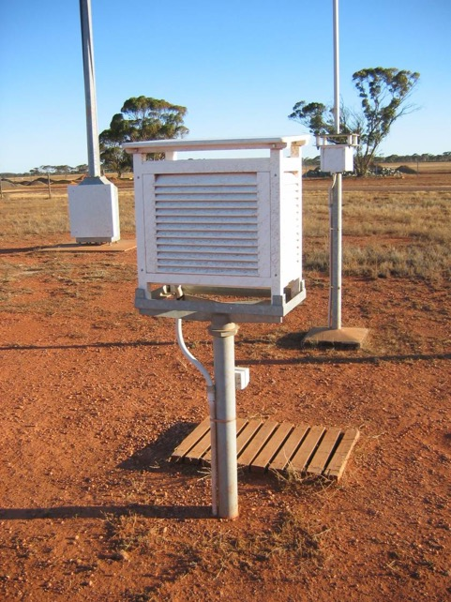
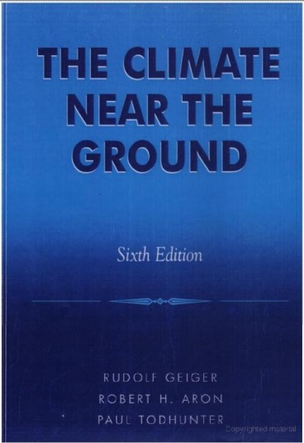
Microclimate

Slide 47


Microclimate
DIRECT SOLAR
RADIATION
SKY THERMAL
RADIATION
SCATTERED SOLAR
RADIATION
EVAPORATION
AIR VELOCITY
AIR TEMPERATURE
0
V_{Z}
V_{ref}
REFLECTED SOLAR
RADIATION
T_{ref}
T_{z}
THERMAL
RADIATION
EVAPORATION
+z
T_{soil,z}
-z
BURROW
T_{deep soil}
(Heat) Energy Balance of the Ground
Solar
(gained)
+
Infra-red
(gained)
=
Infra-red
(lost)
+
Convection
(gained/lost)
+
Conduction
(gained/lost)
+
Evaporation
(gained/lost)

Slide 48
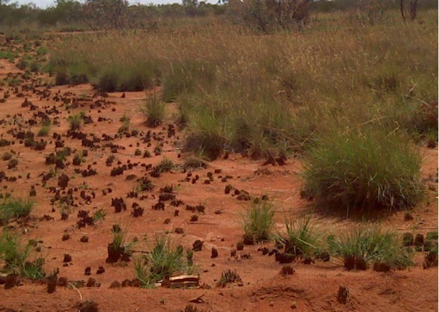


Microclimate
56
54
52
50
48
46
44
42
40
38
36
34
32
51
50
49
48
47
46
45
44
43
42
41
40
39
38
37
36
35

Slide 49

micro_ncep function
Downscaled 250 km resolution 6-hourly gridded data (NCEP)

Slide 50


History of the microclimate model
Niche Mapper
NicheMapR
Porter, W. P., J. W. Mitchell, W. A. Beckman, and C. B. DeWitt. 1973. Behavioral implications of mechanistic ecology - Thermal and behavioral modeling of desert ectotherms and their microenvironment. Oecologia 13:1–54.

Slide 51
Microclimate Program Structure
Niche Mapper
NicheMapR

Slide 52
Microclimate Program Structure

Slide 53

NicheMapR
CPC soil moisture
a) Call to Fortran
Fortran microclimate model library
New et al. 2002
c) User arguments
c
User Input (location, terrain, shade, soil type, …)
microrun.R
d) Climate and soil data sets
e) Global Aerosol Data Set
rungads
c
CampNormTbl9_1
b)
micro_global.R
Fortran GADS library
soil.mon.ltm.v2.nc
GADS Tables
global_climate.nc
f) output
metout
c
soil
c
soilmoist
c
soilpot
c
humid
c
Koepke et al 1997
Notes:
6 mins

Slide 54


Slide 55
Program
Time | Topic
9:00 -9:15 | Introductions
9:15-9:45 | What are mechanistic niche models and why do we need them? (MK & LB)
9:45-10:15 | Calculating body temperature with TrenchR (LB)
10:15-10:30 | Break
10:30-11:15 | Intro to microclimate modelling with NicheMapR (MK)
11:15-12:00 | Selecting microclimate data (LB & MK)
12:00-13:00 | Lunch Break
13:00-13:45 | Calculating body/leaf temperature with NicheMapR (MK)
13:45-14:45 | Mass budgets with NicheMapR: Dynamic energy budgets (DEB) and water balance (MK)
14:45-15:00 | Break
15:00-16:00 | Q&A on mechanistic niche modelling (LB & MK)

Slide 56


Slide 57


Slide 58
Microclimate models in R
Model | Emphasis | Physical explicitness | Reference
NicheMapR | realism, time-series | high | 10.1111/ecog.02360 https://github.com/mrke/
microclima | speed, grids | low | 10.1111/2041-210X.13093 https://github.com/ilyamaclean/
microclimf | speed, grids | med | in progress https://github.com/ilyamaclean/
microclimc | within-canopy | high | 10.1016/j.ecolmodel.2021.109567 https://github.com/ilyamaclean/
TrEnChR | education | low | in review https://github.com/trenchproject/

Slide 59


Slide 60


Spatial and temporal comparison
(Meyer et al. 2023 Ecosphere)

Slide 61

(Meyer et al. 2023 Ecosphere)

Slide 62
micro_x functions
New et al. (2002). A high-resolution data set of surface climate over global land areas. Climate Research, 21(1), 1–25. https://doi.org/10.3354/cr021001
Abatzoglou, et al. (2018). TerraClimate, a high-resolution global dataset of monthly climate and climatic water balance from 1958–2015. Scientific Data, 5(1), 170191. https://doi.org/10.1038/sdata.2017.191
Kalnay et al. (1996). The NCEP/NCAR 40-Year Reanalysis Project. Bulletin of the American Meteorological Society, 77(3), 437–472. https://doi.org/10.1175/1520-0477(1996)077<0437:TNYRP>2.0.CO;2
Hersbach et al. (2020). The ERA5 global reanalysis. Quarterly Journal of the Royal Meteorological Society, 146(730), 1999–2049. https://doi.org/10.1002/qj.3803
Jones et al. Australian Meteorological and Oceanographic Journal, 58(04), 233–248. https://doi.org/10.22499/2.5804.003
micro_global
micro_terra
micro_ncep
micro_era5
micro_aust
micro_usa
micro_uk
micro_nz
Abatzoglou, J. T. (2013). Development of gridded surface meteorological data for ecological applications and modelling. International Journal of Climatology, 33(1), 121–131. https://doi.org/10.1002/joc.3413
Robinson et al. (2017). Climate hydrology and ecology research support system meteorology dataset for Great Britain (1961-2015) [CHESS-met] v1.2. NERC Environmental Information Data Centre. https://doi.org/10.5285/b745e7b1-626c-4ccc-ac27-56582e77b900
Tait et al. (2012). An assessment of the accuracy of interpolated daily rainfall for New Zealand. Journal of Hydrology (New Zealand), 51(1), 25–44. JSTOR.

Slide 63


micro_ncep (and micro_era5) function
Maclean, Mosedale & Bennie (2019). Microclima: An r package for modelling meso- and microclimate. Methods in Ecology and Evolution, 10(2), 280–290. https://doi.org/10.1111/2041-210X.13093
Kearney et al. (2020). A method for computing hourly, historical, terrain-corrected microclimate anywhere on earth. Methods in Ecology and Evolution, 11(1), 38–43. https://doi.org/10.1111/2041-210X.13330

Slide 64
micro_ncep (and micro_era5) function

Slide 65

micro_era5 function

Slide 66






microclimate gridded data
micro_global
micro_terra
micro_ncep
micro_era5
micro_aust
micro_usa
micro_uk
micro_nz

Slide 67
Program
Time | Topic
9:00 -9:15 | Introductions
9:15-9:45 | What are mechanistic niche models and why do we need them? (MK & LB)
9:45-10:15 | Calculating body temperature with TrenchR (LB)
10:15-10:30 | Break
10:30-11:15 | Intro to microclimate modelling with NicheMapR (MK)
11:15-12:00 | Selecting microclimate data (LB & MK)
12:00-13:00 | Lunch Break
13:00-13:45 | Calculating body/leaf temperature with NicheMapR (MK)
13:45-14:45 | Mass budgets with NicheMapR: Dynamic energy budgets (DEB) and water balance (MK)
14:45-15:00 | Break
15:00-16:00 | Q&A on mechanistic niche modelling (LB & MK)

Slide 68

The Heat and Water Budget Model
output
metout
c
soil
c
soilmoist
c
soilpot
c
humid
c
environ
ectotherm.R
c
enbal
c
masbal
c

Slide 69
The Heat and Water Budget Model

Slide 70

shiny apps for NicheMapR
http://bioforecasts.science.unimelb.edu.au/app_direct/ectotherm/

Slide 71

Predicting Ectotherm Evaporation
Metabolism
(gained)
+
Solar
(gained)
+
Infra-red
(gained)
=
Infra-red
(lost)
+
Convection
(gained/lost)
+
Conduction
(gained/lost)
+
Evaporation
(lost)

Slide 72


Predicting Ectotherm Evaporation
Metabolism
(gained)
+
Solar
(gained)
+
Infra-red
(gained)
=
Infra-red
(lost)
+
Convection
(gained/lost)
+
Conduction
(gained/lost)
+
Evaporation
(lost)
Q_{evap,resp} = λ(m_{out,resp} – m_{in,resp})
2.265 kJ/g
latent heat of vaporisation,
J kg⁻¹
A_{evap}
area wet, m²
Q_{evap,cut}= A_{evap}h_{d} (V_{d,skin} - V_{d,air}) λ
mass transfer
coefficient, m s⁻¹
vapor density,
kg m⁻³
V_{d,air}
V_{d,skin}
m_{out}
m_{in}

Slide 74
Program
Time | Topic
9:00 -9:15 | Introductions
9:15-9:45 | What are mechanistic niche models and why do we need them? (MK & LB)
9:45-10:15 | Calculating body temperature with TrenchR (LB)
10:15-10:30 | Break
10:30-11:15 | Intro to microclimate modelling with NicheMapR (MK)
11:15-12:00 | Selecting microclimate data (LB & MK)
12:00-13:00 | Lunch Break
13:00-13:45 | Calculating body/leaf temperature with NicheMapR (MK)
13:45-14:45 | Mass budgets with NicheMapR: Dynamic energy budgets (DEB) and water balance (MK)
14:45-15:00 | Break
15:00-16:00 | Q&A on mechanistic niche modelling (LB & MK)

Slide 75
Endotherm Heat Budgets

Slide 76

Endotherm Heat Budgets
Tcore = 35.7 ºC
energy (food)
water
Requirements
Thermo-
Neutral
zone
Lower critical
temperature (UCT)
Upper critical
temperature (UCT)
TNZ
0
5
10
15
20
25
30
35
40
45
50
Ambient Temperature ºC

Slide 77
NicheMapR
microclimate model
ectotherm model
egg model
endotherm model
dynamic energy budget model
microclimate
DRYAIR
WETAIR
ectotherm
get_p_wet
egg_water
ellipsoid
endoR
endoR_devel
DEB
DEB_const
DEB_var
DEB_euler
plantgro
leaf_temperature
micro_global
micro_terra
micro_ncep
micro_era5
micro_aust
micro_usa
micro_uk
micro_nz
onelump
onelump_var
twolump

Slide 78
heat (and water) budget components
SOLAR_ENDO
CONV_ENDO
SEVAP_ENDO
DRYAIR
WETAIR
solve for balancing metabolic rate
WATER
VAPPRS
RESPFUN
fluid properties
dorsal
+
ventral
SIMULSOL
driving subroutine and geometry
links to R via function endoR
ZBRENT_ENDO
SOLVENDO
c) solve for skin and ‘fur’ temperature, physiological thermoregulation
GEOM_ENDO
functional trait and
microclimate inputs
c
traits
morphology
behaviour
physiology
microclimate
endotherm output
T_{air}
endout
IRPROP
GETKFUR
T_{sky}
c
T_{substrate}
RH
Fur properties
Q_{solar}
…

Slide 79
Thermoregulation Routine
shade/depth/height
posture
flesh conductivity
core temperature
panting
skin wetness
change
>= QBASAL?

